Slide 1



The Metadata Driven Data Warehouse
Ruth Pearson
Barney Lawrence
Emma Dolling
Thu 15:20 GMT Room: MR 1A
@simassoc
simpson-associates

Slide 2
Agenda
INTRODUCTION
Who are we
METADATA
What is Metadata
Where to find it
BUILDING QUERIES
Introducing String_AGG
Building a Simple Query
Building a Complex Query
AZURE DATA FACTORY
Metadata & ADF
Why parameterize?
DML FROM METADATA
Common Patterns
POWER BI
Where to start?
Notes:
The format of this presentation to ensure we cover as much of this very in-depth topic – is that have broken it down into 6 areas.
Firstly – there will be a quick introduction your speakers , next I’ll cover the Metadata, stating what it is where you can find it and what information you can get from it.
Next Barney then we will take us into the building section and will shows how to use the metadata – expect questions
Following Barney – Emma will show you the how to use in your ADF solution but this would also equally apply to SSIS.
and finally back to Barney to show examples , and what is available in Power Bi and again how to make your development easier.

Slide 3














Slide 5
Who Are We?

Slide 6
Ruth Pearson
Support consultant @ Simpson Associates covering the Microsoft BI Stack
Graduated from MMU with a BSc(Hons) in Business Information Technology in 1995
Played the Lead role Madam Wen in the National Eisteddfod of Wales in 1983

Slide 7

Barney Lawrence
Senior Consultant @ Simpson Associates
15 years of BI experience in Local Government, NHS and Travel sectors
Once asked Itzik Ben-Gan which training day sessions he was attending at SQLBits
@SQLBarney

Slide 8

Emma Dolling
Senior Consultant at Simpson Associates
BSc applied computing, working with data for around 15 years
My dog thinks he has to appear in every Teams meeting I have
@Dolled_up_data

Slide 9
Slido
Notes:
Throughout this presentation we will ask questions to keep it interactive but to check you are awake .
To do this we will be using a product called Slido – to get access can you go the following link.

Slide 10


Join at slido.com #3567963
ⓘ Start presenting to display the joining instructions on this slide.

Slide 11
Agenda
INTRODUCTION
Who are we
METADATA
What is Metadata
Where to find it
BUILDING QUERIES
Introducing String_AGG
Building a Simple Query
Building a Complex Query
AZURE DATA FACTORY
Metadata & ADF
Why parameterize?
DML FROM METADATA
Common Patterns
POWER BI
Where to start?

Slide 12
What is metadata?
A dictionary definition would be
Noun - a set of data that describes and gives information about other data.
Notes:
A quick search online in any generic search engine you would get many definitions of what metadata is?
In basic terms is just this information about the data, this is not related to the contents of the tables, files, columns. Etc.

Slide 13
In terms of datawarehouse:-
Metadata is “the data about the data.” Anything that describes the database—as opposed to being the contents of the database—is metadata.
Notes:
In terms of the data warehouse this is about the objects themselves, but is not limited to the contents of the databases it can be about the servers for example.
This aim of this presentation is that we will show you how to find it, use it and ultimately make your working life slightly better.
The topics that will be discussed in most parts apply to on-premise, Paas and Iaas.
An although we are concentrating on the SQL most databases will have something similar.

Slide 14
Why is it useful?
It can help understand your sources, environment and Infrastructure
Classify
Organize
Label
Understand data
Monitoring
Notes:
Instead of writing complex queries to seek database information, we can make use of T-SQL metadata functions to retrieve database info, which helps to save a great amount of time and effort.
Metadata can also be extremely useful when trying to monitor your environment for example however this is a whole topic which we briefly mentioned today.
First Question

Slide 15

How often do you use metadata in your role?
ⓘ Start presenting to display the poll results on this slide.
Notes:
First question?
Looks at the results

Slide 16
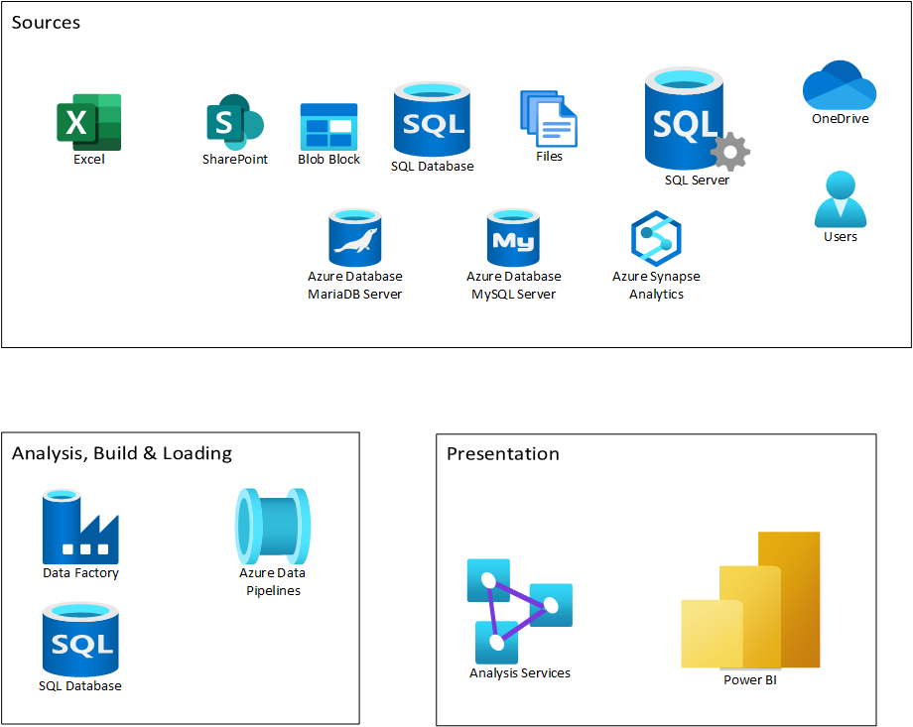
Where can you find it?
Notes:
Within an ETL solution there are many places were the use of Metadata can help you stream line your coding and help automate repetitive tasks.

Slide 17
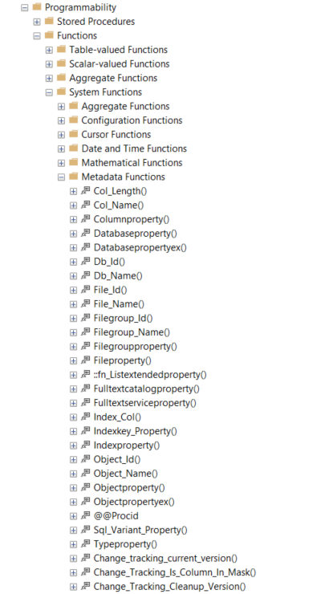
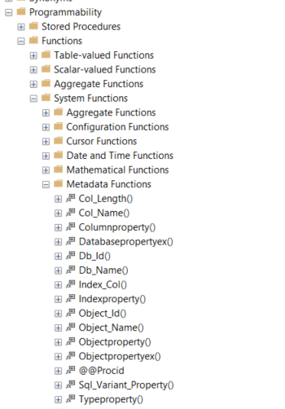
SSMS - Functions
On-prem
Azure
Metadata Functions
Notes:
The easiest place to start is with Management studio. In the database under programmability, under function there is a special folder called Metadata functions. This exist for on-prem and Azure.
There are some useful ones to note, probably the most well know
Is Object_id

Slide 18
SSMS – Metadata functions examples
Object_id
DROP TABLE IF EXISTS SQlBitsTable
Prior to 2014
IF EXISTS (SELECT 1 FROM sys.objects
WHERE object_id = OBJECT_ID(N'SQlBitsTable')
AND type = N'U’)
DROP TABLE SQlBitsTable
Notes:
especially when combined with an If Exists when you need to check the existence of view, constraint, tables etc, before creation or deletion for example

Slide 19
Not just data
select @@VERSION – to get the software version installed
Select @@LANGUAGE – the get the language current being used
Select @@ROWCOUNT – gets the number of rows affected by the last statement
Notes:
But you can get Metadata about a variety of objects from your server specification, installed version of software to details about the session

Slide 20
System tables
sys.dm_os_windows_info - Returns a miscellaneous set of useful information about the computer, and about the resources available to and consumed by SQL Server
sys.dm_server_services - Returns information about the SQL Server, Full-Text, SQL Server Launchpad service (SQL Server 2017+), and SQL Server Agent services in the current instance of SQL Server
sys.dm_os_sys_info - Returns a miscellaneous set of useful information about the computer, and about the resources available to and consumed by SQL Server;
sys.sysprocesses - Contains information about processes that are running on an instance of SQL Server;
sys.sql_logins - Returns one row for every SQL Server authentication login;
sys.databases Contains one row per database in the instance of SQL Server
Notes:
This brings us on nicely to the next part the system tables & views.
Although those functions are useful there are a host of information stored in various tables, views and DMV’s or Server Dynamic Management View’s.
For example
sys.dm_os_windows_info give Returns a miscellaneous set of useful information about the computer, and about the resources available to and consumed by SQL Server
DMV’s are your friend ☺

Slide 21
Dynamic management View (DMV’s)
Sys.dm_exec_connections - Returns information about the connections established to this instance of the database engine and the details of each connection.
sys.dm_exec_sessions - Returns one row per authenticated session on SQL Server. sys.dm_exec_sessions is a server-scope view that shows information about all active user connections and internal tasks. This information includes client version, client program name, client login time, login user, current session setting, and more
Sys.dm_exec_requests - Returns information about each request that is executing in SQL Server.
Notes:
Dynamic management views (DMV) and functions return server state information that can be used to monitor the health of a server instance, diagnose problems, and tune performance.
A few of our favorite ones are shown

Slide 22
Information_Schema
INFORMATION_SCHEMA.SCHEMATA - Returns one row for each schema in the current database..
INFORMATION_SCHEMA.TABLES - Returns one row for each table or view in the current database for which the current user has permissions.
INFORMATION_SCHEMA.VIEWS - Returns one row for each view that can be accessed by the current user in the current database.
INFORMATION_SCHEMA.ROUTINES - Returns one row for each stored procedure and function that can be accessed by the current user in the current database. The columns that describe the return value apply only to functions. For stored procedures, these columns will be NULL.
INFORMATION_SCHEMA.COLUMNS - Returns one row for each column that can be accessed by the current user in the current database.
INFORMATION_SCHEMA.VIEWS - Returns one row for each view that can be accessed by the current user in the current database. .
Notes:
The information_schema is another way that SQL Server provides metadata, which can help if you are trying to understand a source database.
Here are a few examples of ones we use frequently – you see examples soon.#

Slide 23
Stored Procedures
Sp_help - Reports information about a database object (any object listed in the sys.sysobjects compatibility view), a user-defined data type, or a data type
sp_helpsort - returns the default collation for a database
Sp_tables - Returns a list of objects that can be queried in the current environment. This means any table or view, except synonym objects
sp_server_info
sp_foreignkeys - Returns the foreign keys that reference primary keys on the table
sp_columns - Returns column information for the specified objects that can be queried in the current environment.
sp_databases – list the database that resides in an instance
sp_table_privileges - reutnrs a alist of tables permissions , insert, deleted, update etc.
sp_stored_procedures - list all the stored procedures in the current environment
Notes:
Here are some examples of the System Stored procedures
SP_Helpsort - returns the default collation for a database.
Sp_databases – list the database that resides in an instance
Sp_table_privileges – returns a list of tables permissions , insert, deleted, update etc.
SP_Stored _Procedures list all the stored procedures in the current environment.
SP_help - Did you know the sp_help is linked to windows shortcut – Highlight a table and Alt + F1 (screenshot)

Slide 24
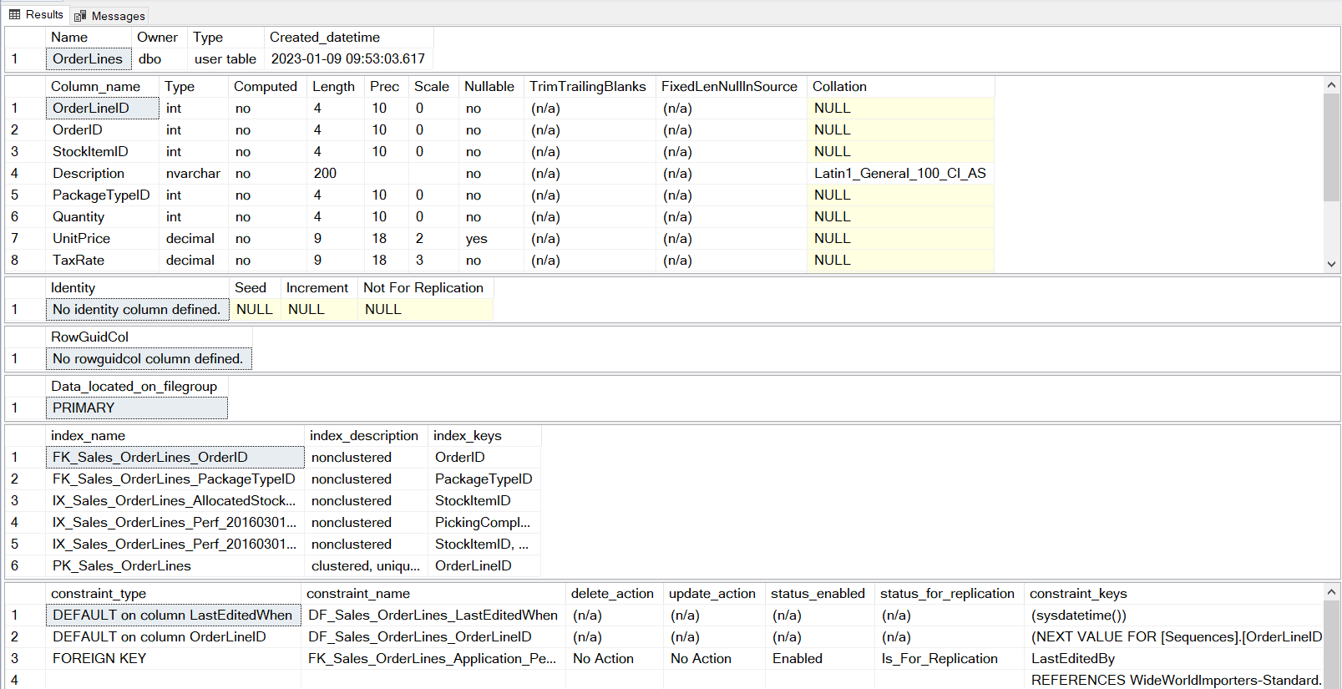
Sp_help Results
Notes:
This was done on the Order line table in the WorldWide Importers database

Slide 25
Agenda
INTRODUCTION
Who are we
METADATA
What is Metadata
Where to find it
BUILDING QUERIES
Introducing String_AGG
Building a Simple Query
Building a Complex Query
AZURE DATA FACTORY
Metadata & ADF
Why parameterize?
DML FROM METADATA
Common Patterns
POWER BI
Where to start?

Slide 26
Building With Metadata
SQL Server 2017 & Onwards
STRING_AGG
Earlier versions
That ugly thing involving FOR XML and STUFF

Slide 27
WordId | Word
1 | Hello
2 | World
3 | From
4 | Ruth
5 | Emma
6 | And
7 | Barney
SELECT
STRING_AGG(Word,' ')
AS MyPhrase
FROM #MyText;

Slide 28
What will STRING_AGG return?
ⓘ Start presenting to display the poll results on this slide.

Slide 29
And Barney Emma From Hello Ruth World

Slide 30
CREATE TABLE #MyText
(
WordId int,
Word varchar(50),
CONSTRAINT Pv_Mytext PRIMARY KEY CLUSTERED (Word ASC)
)

Slide 31
WordId | Word
1 | Hello
2 | World
3 | From
4 | Ruth
5 | Emma
6 | And
7 | Barney
SELECT
STRING_AGG(Word,' ‘)
AS MyPhrase
FROM #MyText;
WITHIN GROUP (ORDER BY WordId)

Slide 32
Hello World From Ruth Emma And Barney

Slide 33
SELECT
STRING_AGG(
C.COLUMN_NAME,
', ‘
) AS ColumnList
FROM INFORMATION_SCHEMA.COLUMNS AS C
WHERE
C.TABLE_SCHEMA = 'Sales'
AND C.TABLE_NAME = 'OrderLines'
OrderLineID, OrderID, StockItemID, Description, PackageTypeID, Quantity, UnitPrice, TaxRate, PickedQuantity, PickingCompletedWhen, LastEditedBy, LastEditedWhen

Slide 34
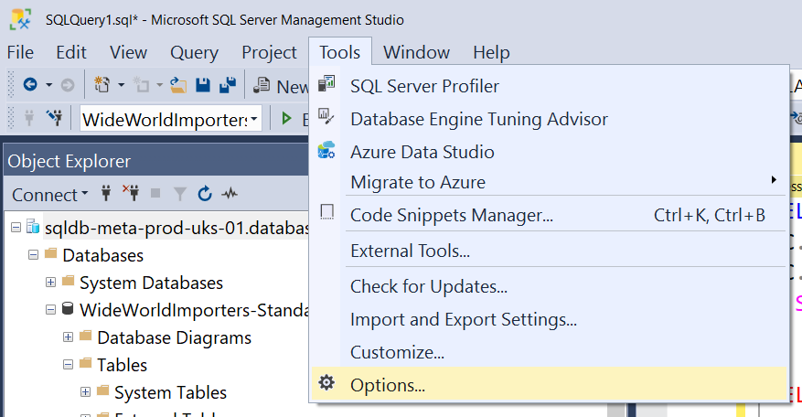
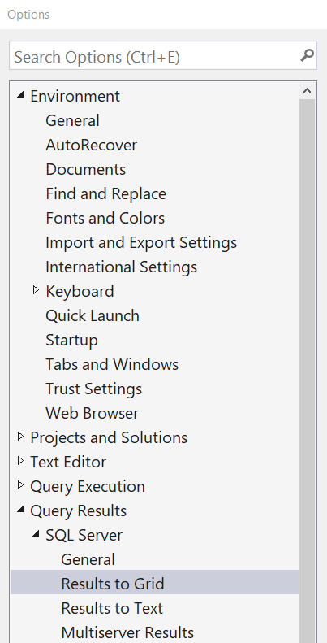
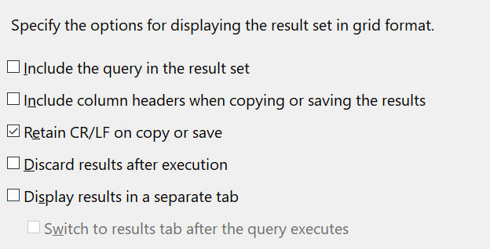

Slide 35
OrderLineID,
OrderID,
StockItemID,
Description,
PackageTypeID,
Quantity,
UnitPrice,
TaxRate,
PickedQuantity,
PickingCompletedWhen,
LastEditedBy,
LastEditedWhen
SELECT
STRING_AGG(
C.COLUMN_NAME,
', ' + char(13) + char(10)
) AS ColumnList
FROM INFORMATION_SCHEMA.COLUMNS AS C
WHERE
C.TABLE_SCHEMA = 'Sales'
AND C.TABLE_NAME = 'OrderLines'

Slide 36
SELECT TABLE_SCHEMA, TABLE_NAME,
'
SELECT
'+
STRING_AGG(
QUOTENAME(C.COLUMN_NAME),
', ' + char(13) + char(10) + char(9)
) WITHIN GROUP (ORDER BY C.ORDINAL_POSITION)
+'
FROM '+ TABLE_SCHEMA +'.'+ TABLE_NAME
AS SelectStatement
FROM INFORMATION_SCHEMA.COLUMNS AS C
GROUP BY TABLE_SCHEMA, TABLE_NAME

Slide 37
SELECT
[OrderLineID],
[OrderID],
[StockItemID],
[Description],
[PackageTypeID],
[Quantity],
[UnitPrice],
[TaxRate],
[PickedQuantity],
[PickingCompletedWhen],
[LastEditedBy],
[LastEditedWhen]
FROM Sales.OrderLines

Slide 38
COLUMN_NAME

Slide 39
'MIN('+COLUMN_NAME+') AS MIN_'+COLUMN_NAME
COLUMN_NAME

Slide 40
'MAX('+COLUMN_NAME+') AS MAX_'+COLUMN_NAME
COLUMN_NAME

Slide 41
'COUNT(DISTINCT ‘+
COLUMN_NAME
+') AS DISTINCT_'+COLUMN_NAME
COLUMN_NAME

Slide 42
'MAX(LEN(‘+
COLUMN_NAME
+’))) AS LENGTH_'+COLUMN_NAME
COLUMN_NAME

Slide 43
SELECT TABLE_SCHEMA, TABLE_NAME
,'
WITH DistinctCounts AS
(
SELECT '
+ STRING_AGG(CAST('' AS varchar(max)) +
'COUNT(DISTINCT [' + COLUMN_NAME +']) AS [DISTINCT_' + COLUMN_NAME +']' + CHAR(13)
+',COUNT(IIF([' + COLUMN_NAME +'] IS NULL,1,NULL)) AS [NULL_' + COLUMN_NAME +']' + CHAR(13)
+',COUNT(IIF(CAST([' + COLUMN_NAME +'] AS varchar(max)) = '''' ,1,NULL)) AS [BLANK_' + COLUMN_NAME +']' + CHAR(13)
+',MAX(LEN([' + COLUMN_NAME +'])) AS [MAXLENGTH_' + COLUMN_NAME +']' + CHAR(13)
+',MIN([' + COLUMN_NAME +']) AS [MIN_' + COLUMN_NAME +']' + CHAR(13)
+',MAX([' + COLUMN_NAME +']) AS [MAX_' + COLUMN_NAME +']' + CHAR(13)
+',''' + DATA_TYPE + ISNULL('(' +CAST(COALESCE(CHARACTER_MAXIMUM_LENGTH,DATETIME_PRECISION) AS varchar(5)) + ')','') +''' ' + ' AS [DATA_TYPE_' + COLUMN_NAME +']' + CHAR(13)
,', ') WITHIN GROUP (ORDER BY ORDINAL_POSITION) + '
FROM ' + TABLE_SCHEMA + '.' + TABLE_NAME + '
)
SELECT ''' + TABLE_SCHEMA +''' AS TableSchema, ''' + TABLE_NAME + ''' AS TableName, V.ColumnName,
V.DistinctColumnCount,V.NullColumnCount,V.BlankColumnCount,V.MaxColumnLength,V.MinColumnValue,V.MaxColumnValue,V.ColumnDataType
FROM DistinctCounts AS C
CROSS APPLY
(
VALUES
'+
STRING_AGG( CAST('' AS varchar(max)) +
'(''' + COLUMN_NAME
+ ''', C.[DISTINCT_' + COLUMN_NAME + ']'
+ ', C.[NULL_' + COLUMN_NAME + '] '
+ ', C.[BLANK_' + COLUMN_NAME + '] '
+ ', C.[MAXLENGTH_' + COLUMN_NAME + ']'
+ ', CAST(C.[MIN_' + COLUMN_NAME + '] AS varchar(max))'
+ ', CAST(C.[MAX_' + COLUMN_NAME + '] AS varchar(max))'
+ ', C.[DATA_TYPE_' + COLUMN_NAME + ']' +')'
+ CHAR(13)
,', ') WITHIN GROUP (ORDER BY ORDINAL_POSITION)
+'
) AS V(ColumnName,DistinctColumnCount,NullColumnCount,BlankColumnCount,MaxColumnLength,MinColumnValue,MaxColumnValue,ColumnDataType)
;'
AS Query
FROM INFORMATION_SCHEMA.COLUMNS
GROUP BY TABLE_SCHEMA, TABLE_NAME

Slide 45
Agenda
INTRODUCTION
Who are we
METADATA
What is Metadata
Where to find it
BUILDING QUERIES
Introducing String_AGG
Building a Simple Query
Building a Complex Query
AZURE DATA FACTORY
Metadata & ADF
Why parameterize?
DML FROM METADATA
Common Patterns
POWER BI
Where to start?

Slide 46
Azure Data Factory
Metadata & ADF
Why parameterize?

Slide 47
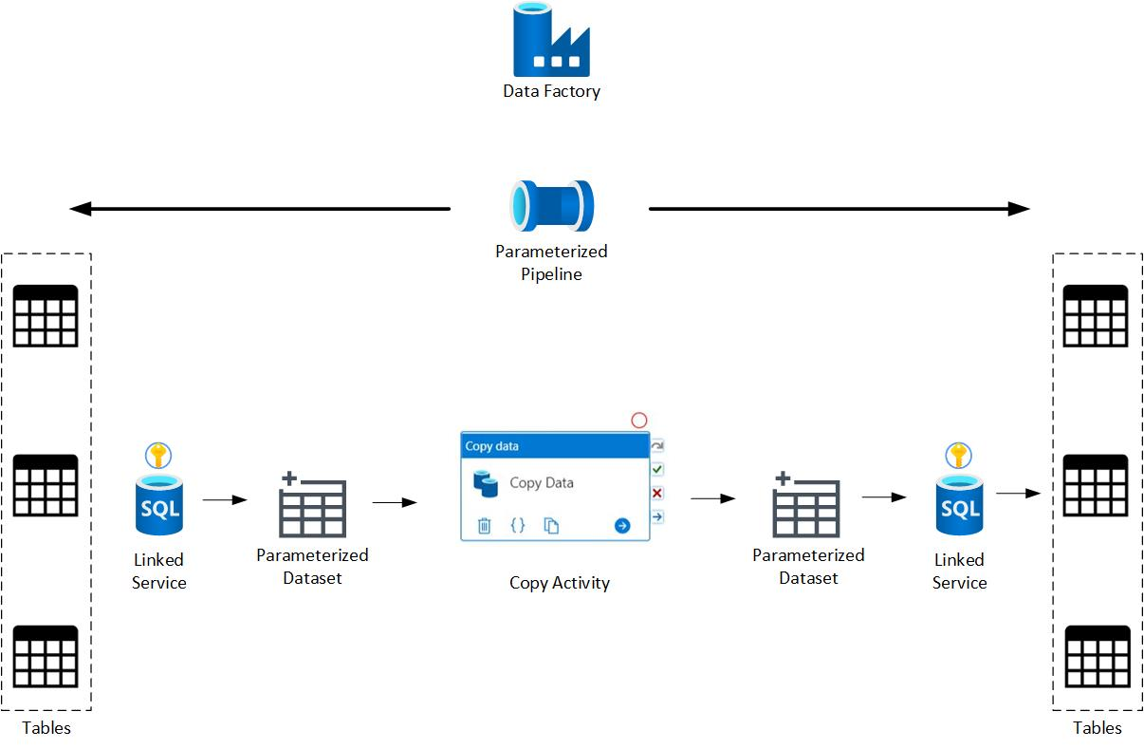
Data Movement
Notes:
So what does that look like from a data movement perspective? How do we use meta data in this part of the process? The image shows where parameters can be added in the orchestration of data.

Slide 48

Why use parameters?
Connection Parameters
Dynamically input filenames
Dynamically output table names
Append details to output filenames
Notes:
Parameterization can be used in many ways, with such use cases being connection parameters, filenames, output tables and appending details to filenames in outputs. There are other uses cases for it, these are just a few examples.
Although we have done this step in ADF it is possible to orchestrate data using other software, SSIS, Synapse Pipelines etc

Slide 49
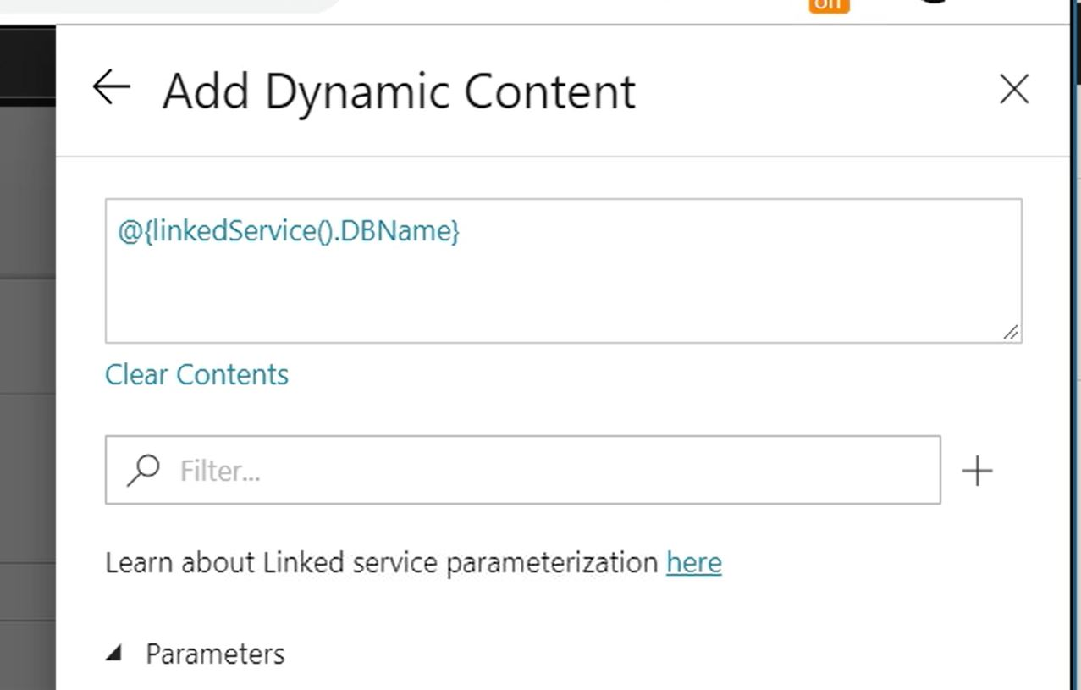
Establish Connection
Notes:
To begin with we need to look at establishing the connection for the linked service as everything in ADF starts here
When you parameterize a Data Source in ADF the Credentials are passed at run time so that there isn’t a requirement to constantly create connections to data sources.
When creating these connections it’s a good idea to parameterize the secret name and store any credentials in Azure Key Vault to make the environment more secure
Screenshot shows parameters input for database connection.

Slide 50
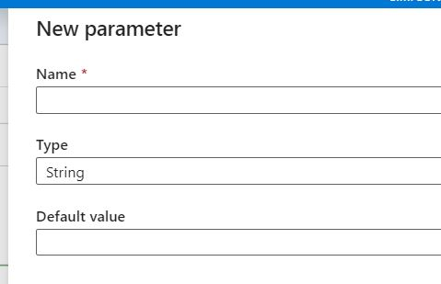
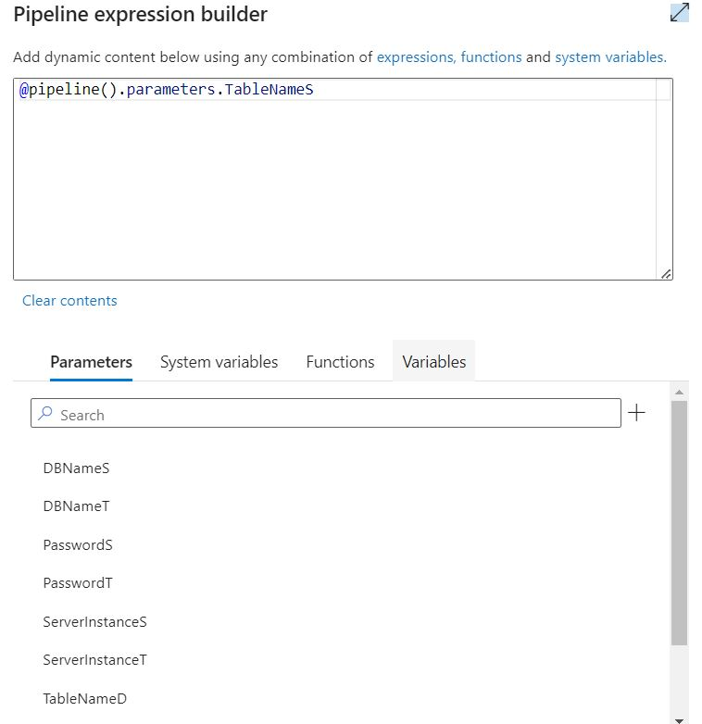
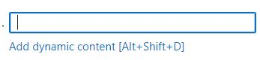
Create Parameters
Notes:
When creating parameters you need to select the dynamic content option that shows underneath the field you wish to populate and add in the parameter details.

Slide 51
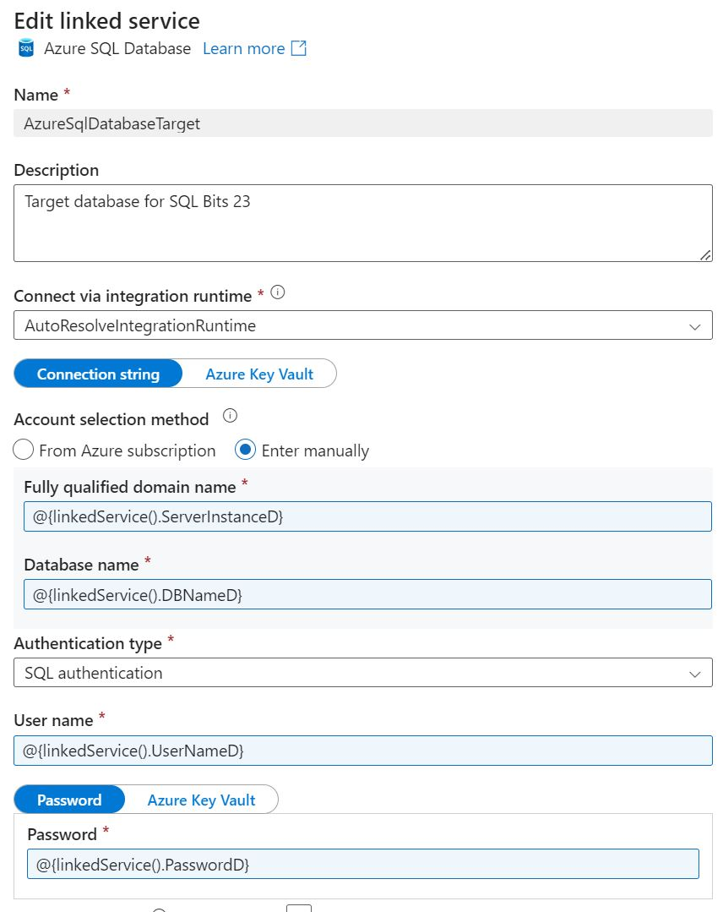
Parameters
Notes:
The linked service parameters shown here cover the Server/Instance Name, the database name, the username, password and table name.
Adding parameters in this way means that at runtime we should have a single pipeline using a single dataset with a single linked service
Key vault

Slide 52
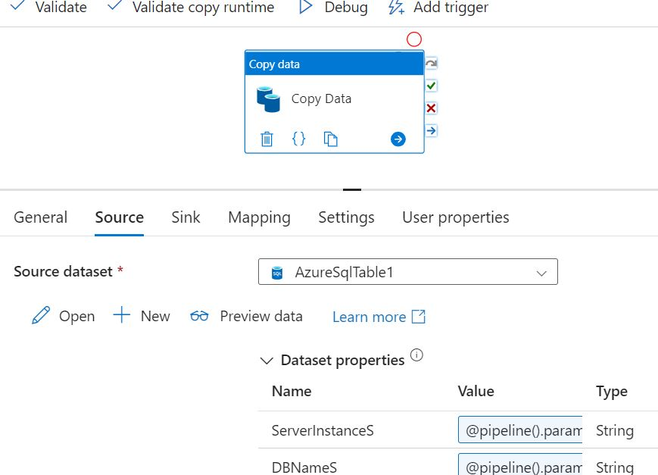
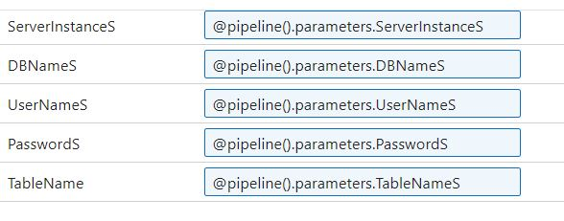
Copy Data Activity
Notes:
Using the parameterized information, we can then start to look at moving the data.
This activity will allow you to move data from source to target.
We can leverage global parameters in each pipeline to move the data.
It is possible to create target tables at this point as part of the activity by selecting the create table box within the copy activity, this then creates the table based on the meta data from the source.

Slide 53
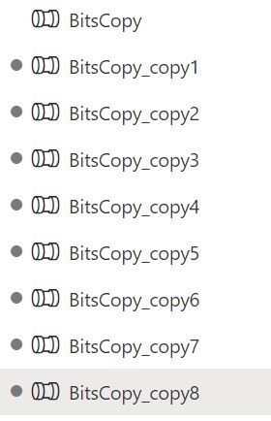
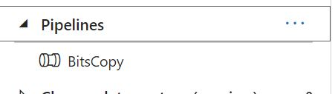
Pipelines
Notes:
Once connected we need to think about data movement and pipelines, ADF is an orchestration tool that can be used for that purpose.
Within the workspace it is possible to have multiple pipelines.
Parameters can be defined within a pipeline to be reused over and over again
Pipelines that aren’t meta data driven can leave you with something like the image shown on the left
By parameterizing values pipelines have the power to become a pipeline

Slide 54
Agenda
INTRODUCTION
Who are we
METADATA
What is Metadata
Where to find it
BUILDING
String_AGG
Beginners - String_AGG
Advanced - String_AGG
AZURE DATA FACTORY
Metadata & ADF
Why parameterize?
DML FROM METADATA
Common Patterns
POWER BI
Where to start?

Slide 55
TRUNCATE TABLE FACT.OrderLines
INSERT INTO FACT.OrderLines
SELECT
[OrderID],
[OrderLineNo],
[Column1],
[Column2],
[Column3]
FROM STAGING.OrderLines AS S
WHERE NOT EXISTS (
SELECT *
FROM FACT.OrderLines AS T
WHERE
S.OrderID = T.OrderID
AND S.OrderLineNo = T.OrderLineNo)

Slide 56
What Next?
Delete – Insert Pattern Backwards
Update – Join the tables, build the update list, change detection
Merge or Upsert – Do all three

Slide 57
Steps to Implementing Metadata
Land data fast. ELT not ETL.
Sort your data types.
Use views, lots of views (views are meta data).
SELECT INTO to get started with your tables.
USE SSMS script as and tweak the output.
Hand write a template and generalise it – meta data is your co-pilot.
Steadily automate, build your armoury of re-usable snippets.
Dynamically generate and persist vs dynamic on the fly.

Slide 58
Agenda
INTRODUCTION
Who are we
METADATA
What is Metadata
Where to find it
BUILDING
String_AGG
Beginners - String_AGG
Advanced - String_AGG
AZURE DATA FACTORY
Metadata & ADF
Why parameterize?
DML FROM METADATA
Common Patterns
POWER BI
Where to start?

Slide 59

?

Slide 60
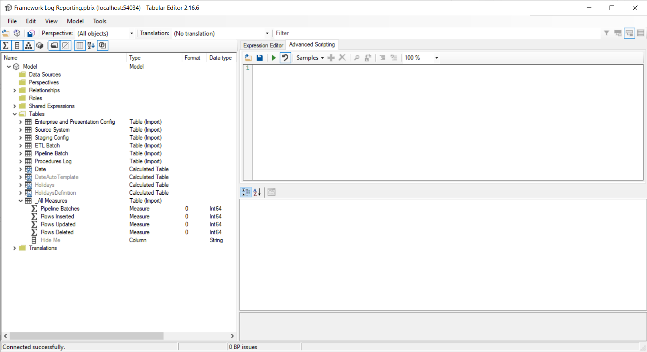

Slide 63
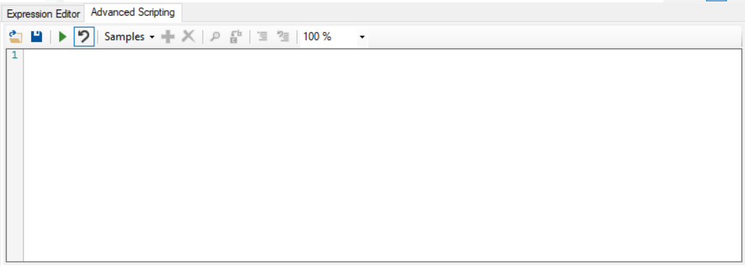
Useful script snippets | Tabular Editor Documentation

Slide 64
// Creates a SUM measure for every currently selected column and hide the column.
foreach(var c in Selected.Columns)
{
var newMeasure = c.Table.AddMeasure(
"Sum of " + c.Name, // Name
"SUM(" + c.DaxObjectFullName + ")", // DAX expression
c.DisplayFolder // Display Folder
);
// Set the format string on the new measure:
newMeasure.FormatString = "0.00";
// Provide some documentation:
newMeasure.Description = "This measure is the sum of column " + c.DaxObjectFullName;
// Hide the base column:
c.IsHidden = true;
}

Slide 65
Summary
Notes:
Before I summarized are there an y questions

Slide 66
Q & A

Slide 67
How often will you use metadata in the future?
ⓘ Start presenting to display the poll results on this slide.

Slide 68
Driving with Metadata – The Three Stages
Notes:
Conclusion. We’ve seen the tools metadata provides us with and there are three stages towards the metadata driven data warehouse.

Slide 69

Driving with Metadata – Stage One
Metadata as a Map
Notes:
Stage 1: Metadata provides you with a map. It shows you where things are and what you can expect to find when you get to them

Slide 70

Driving with Metadata – Stage Two
Metadata as Your Co-Pilot
Notes:
Stage 2: Metadata becomes your co-pilot, and you build together using script snippets, templates and built in tools to let metadata take the grunt work out of coding tasks.

Slide 71

Driving with Metadata – Stage Three
Metadata drives your data warehouse
Notes:
Stage 3: Now metadata takes the wheel. Through collections of metadata, dynamic code and pipelines and, suitable tooling, large parts of the data warehouse build itself. Your task becomes one of guiding it and working to develop the code behind the functional code that extracts, loads and transforms your data.

Slide 72

But Wait There’s More!
Getting Meta with your Metadata
Notes:
Stage 3 may be all you ever need, you’ve built your data warehouse, it’s easy to maintain and expand and will serve you for years to come. But there’s a layer beyond that for those of us whose next task is to move on to build another data warehouse, and another and another.
This is the realm of frameworks where the full build becomes repeatable.

Slide 73
What is a Metadata Driven Data Warehouse: The ETL framework
Is our approach to Quality Assurance
ETL procedures can be complex and varies between use cases, which is why we have built standardized inputs and processes.
All solution are different but at their core they have the same underlying mechanisms.
We have worked with hundreds of clients across a range or industries and our ETL framework was born out of real work challenges experience by our services team in collaboration with both technical and business stakeholders.
Notes:
At Simpson Associates we have developed apon these few basis principles and have developed our ETL Framework, which has been developed through over 30 years in the industry solving customers issues across many industries, to allow us to deliver in a quality assured way.
Key points:- Having done it hard way or the long way we are able to package our lessons learnt to benefits all our customers. This is continually evolving based on current customer requirements and improvements in the underlying technologies.
It’s a times saver for customer in terms of time, cost and mitigates risks through quality assurance.
What to hear more Go and visit out stand 8 next to Community Corner.

Slide 74
Stand 8 (next to Community Corner)
t: +44 (0) 1904 234 510
e: info@simpson-associates.co.uk
www.simpson-associates.co.uk
https://sqlb.it/?10093
@simassoc
simpson-associates

